Slide 1

GLOBAL POWER PLATFORM BOOTCAMP
Organized Globally, Held Locally
Lalit Mohan
Collaboration Analyst - Allegion
@LalitMGupta
@GPPBootcampBLR #GPPBootcampBLR #GlobalPowerPlatformBootcamp

Slide 2
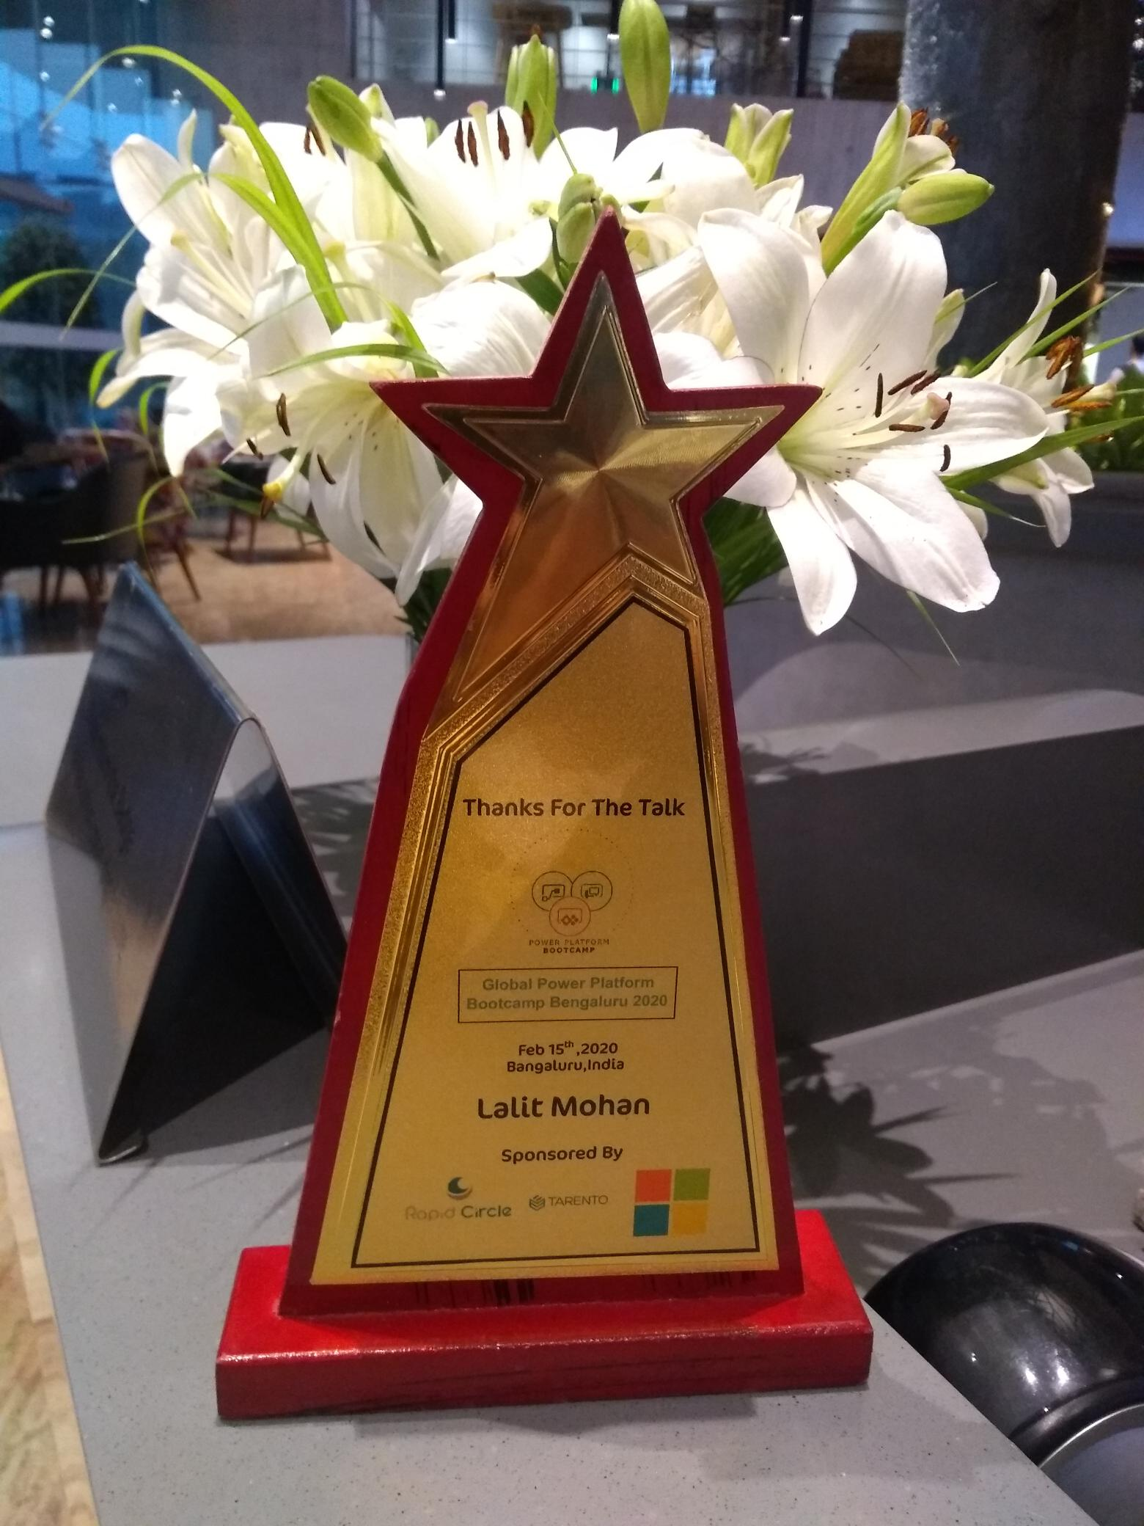
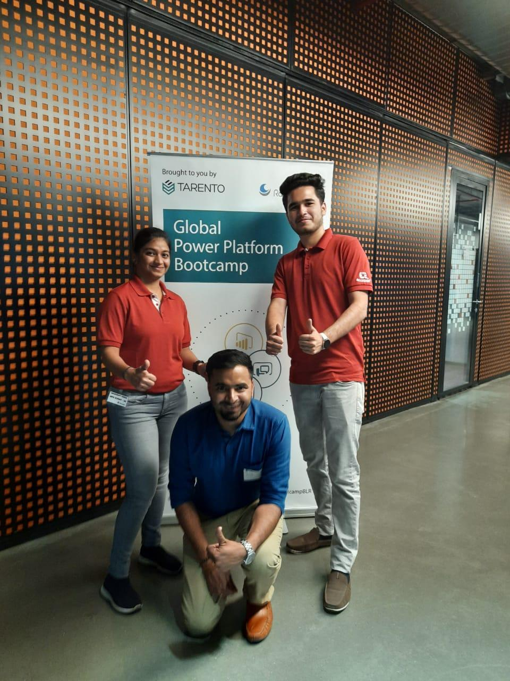
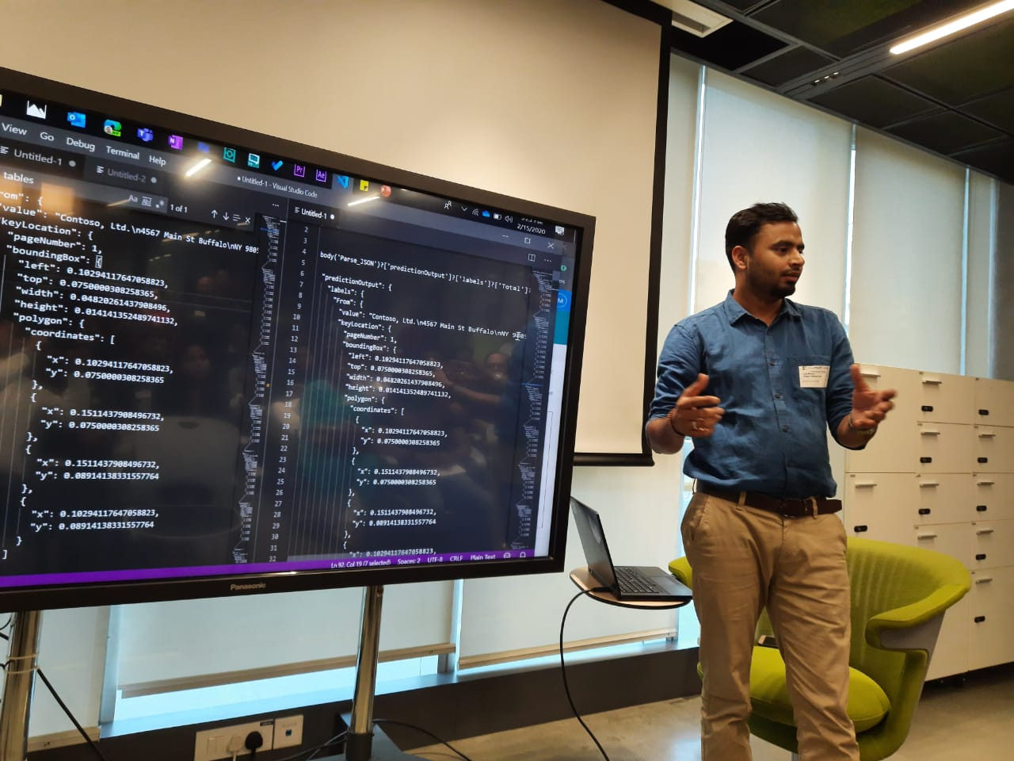

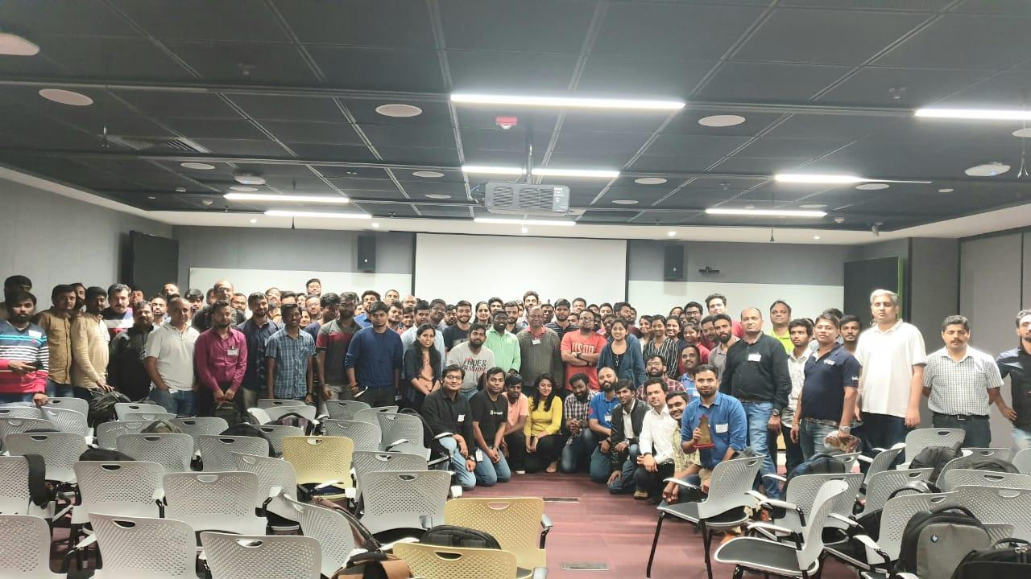




Delivered session on AI builder capability at the Global Power Platform Bootcamp, Microsoft, Bangalore 2020.
A phenomenal event with the massive 300+ PowerAddicts audience, Keep learning in a world that never stops changing!

Slide 3
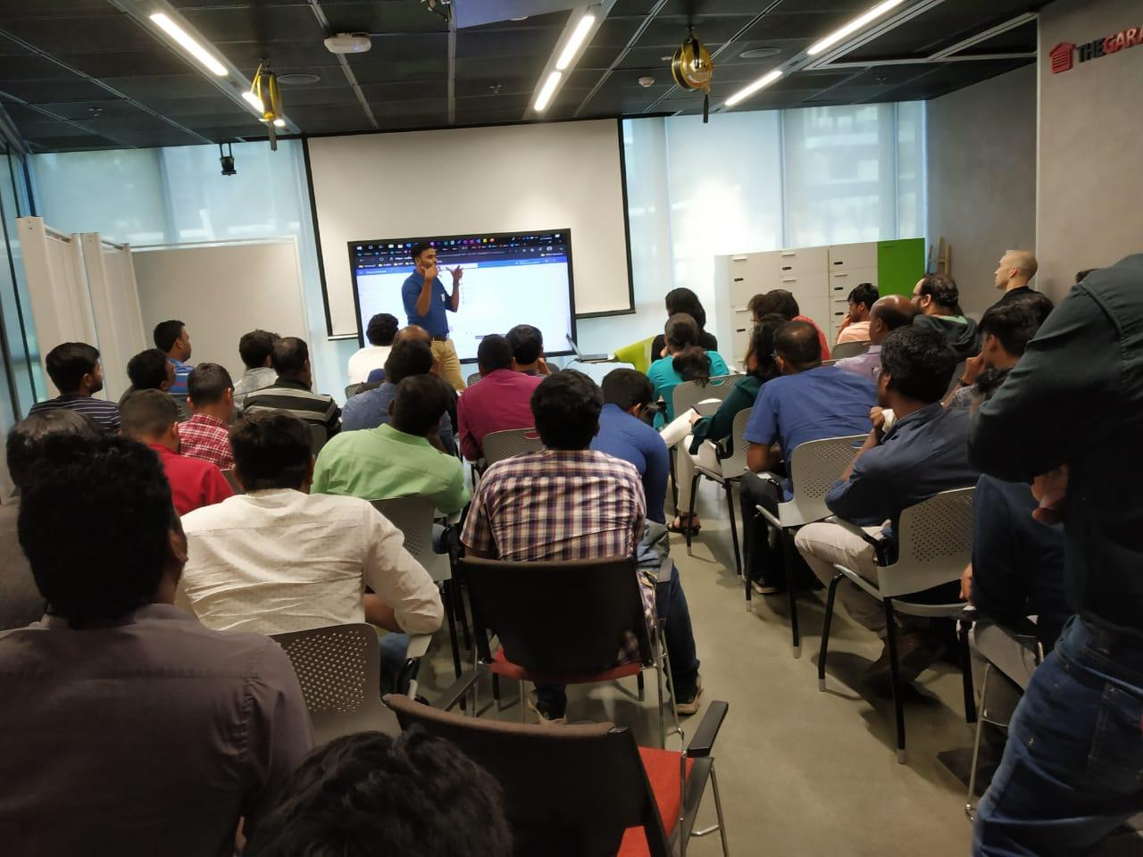
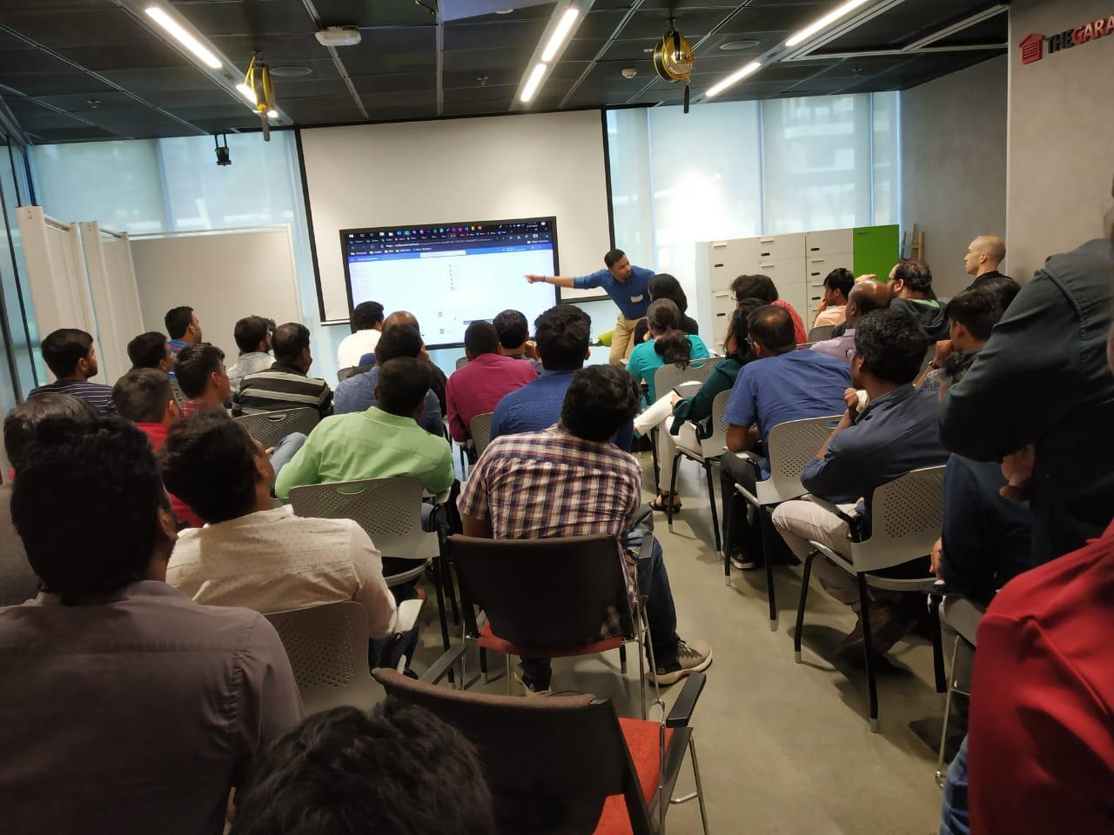
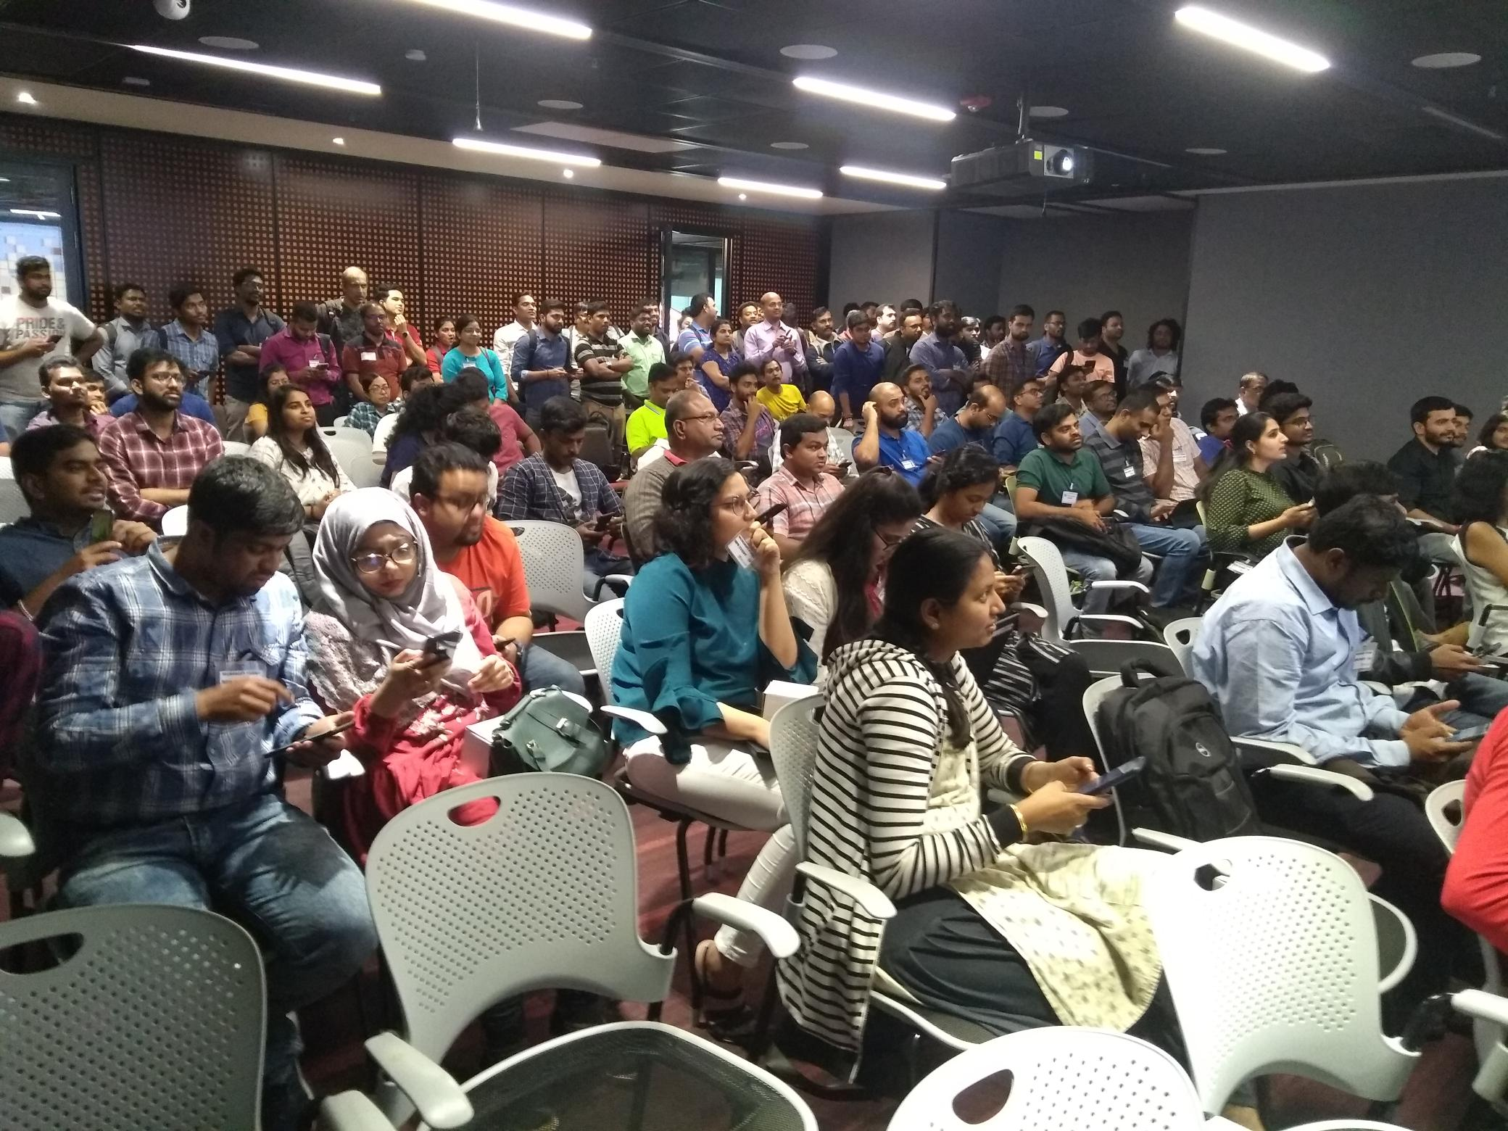

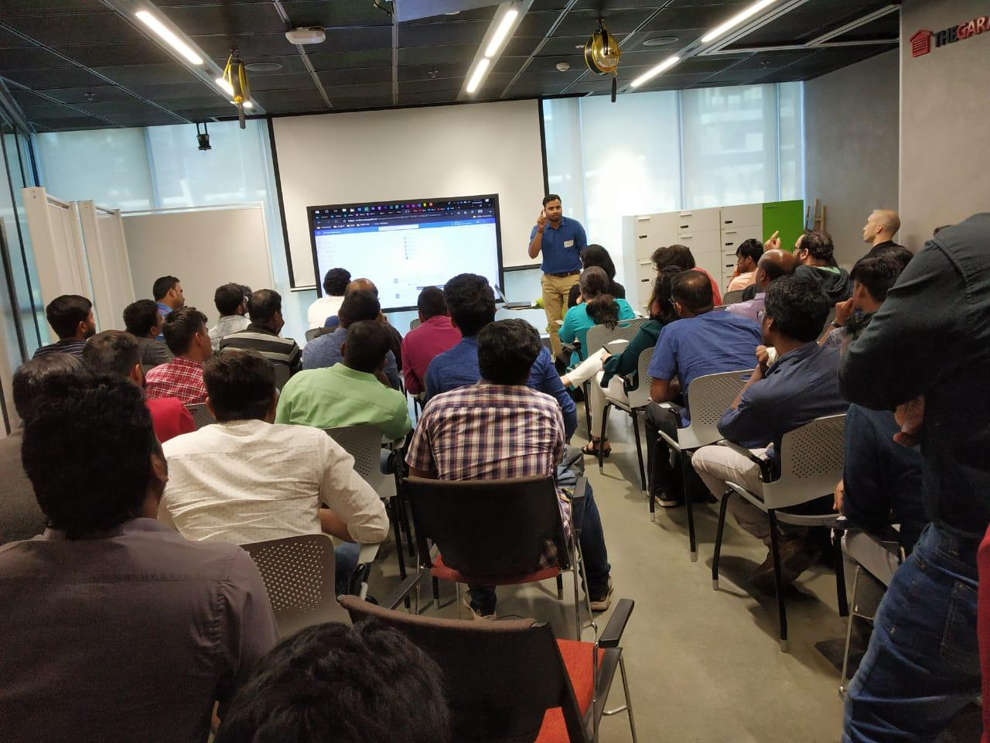

Slide 4
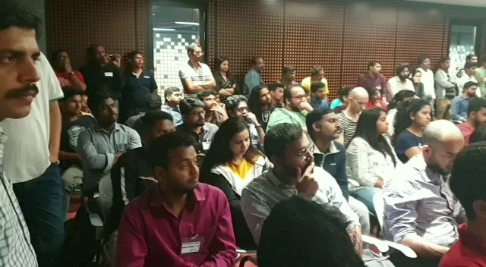
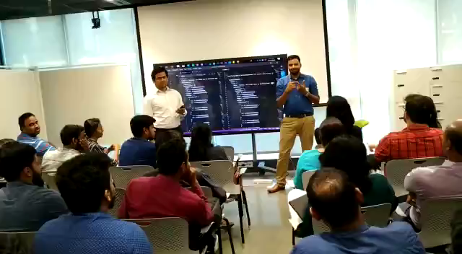
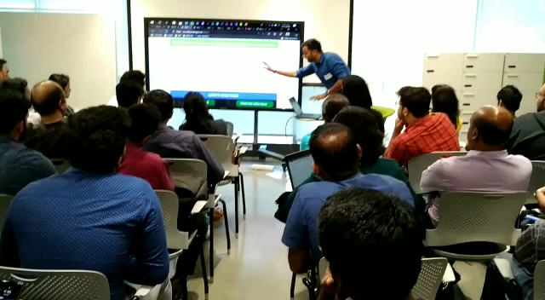
Video Glimpse

Slide 5

Introducing AI Builder to LOB apps using Microsoft PowerApps and Power Automate
Lalit Mohan
Collaboration Analyst - Allegion
@LalitMGupta
@GPPBootcampBLR #GPPBootcampBLR
#GlobalPowerPlatformBootcamp

Slide 6



Sponsors

Slide 7
What is Microsoft Power Platform?
Low-code development platform to enable the last mile of the digital transformation.
What it is include?
Power BI, Power Apps, Power Automate and Power Virtual Agents
Why we use ?
Easy to build dashboard, applications, and workflow

Slide 8
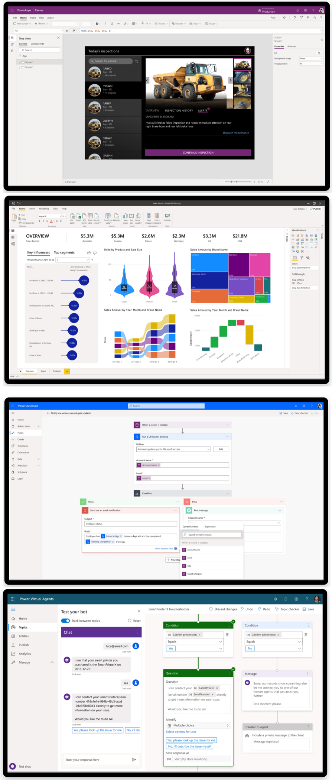
Power Apps
Turn ideas into organisational solutions by enabling everyone to build custom apps that solve business challenges.
Learn more
Power BI
Make informed, confident business decisions by putting data-driven insights into everyone’s hands.
Learn more
Power Automate
Boost business productivity to get more done by giving everyone the ability to automate organisational processes.
Learn more
Power Virtual Agents
Easily build chatbots to engage conversationally with your customers and employees—no coding required.
Learn more

Slide 9

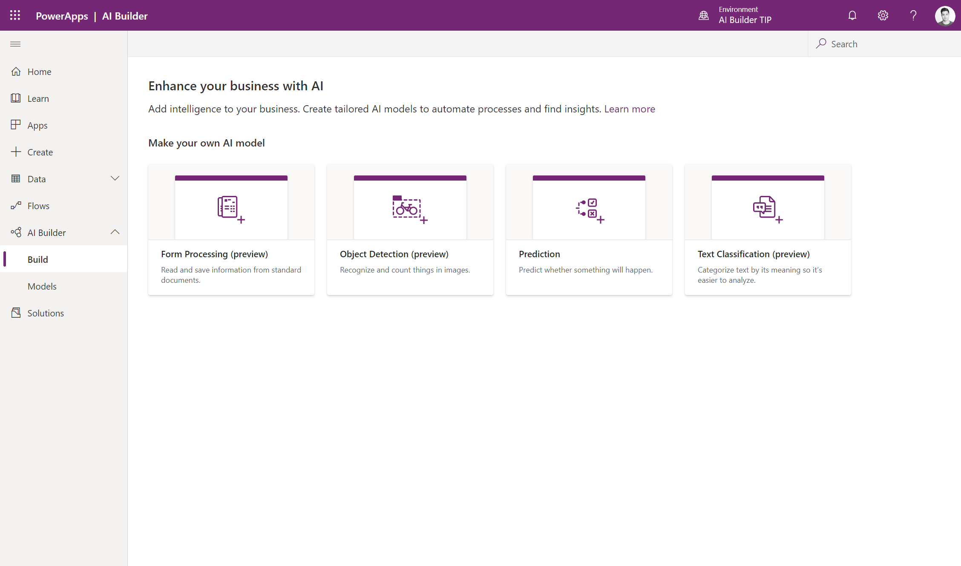
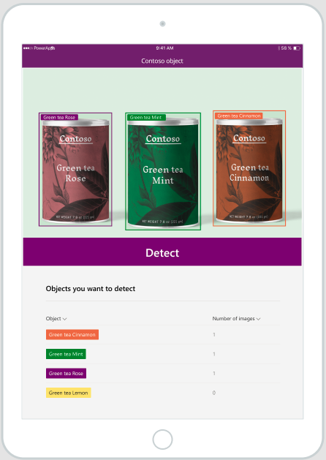


Introducing AI Builder AI for every app. And everyone.

Slide 10


AI Builder
Easy to use
Guided point-and-click AI applications
Empowering
AI for every skill level
Extensible
Embedded within the Microsoft Power Platform and Dynamics 365
No need to manage AI infrastructure & complexity
Security, compliance, user roles

Slide 11



AI Builder
A low-code AI capability that spans the Microsoft Power Platform, Dynamics 365, and Office 365
Analyze, Act, Automate
Power BI
Business analytics
Power Apps
Application development
Power Automate
Process automation
Power Virtual Agents
Intelligent virtual agents
Data connectors
Common Data Service
AI Builder

Slide 12
AI must be democratized to accelerate digital transformation
we are here
Paper-based
Manual
Experts
App-based
Digital
Business users
Apps + AI
Automated
Business users

Slide 13
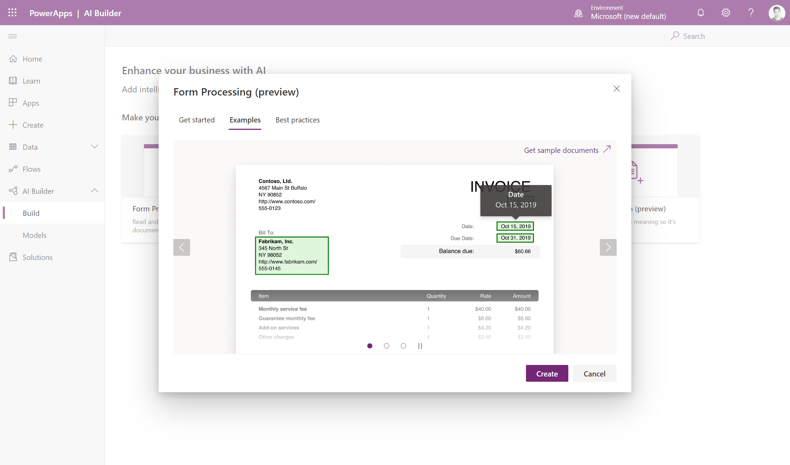
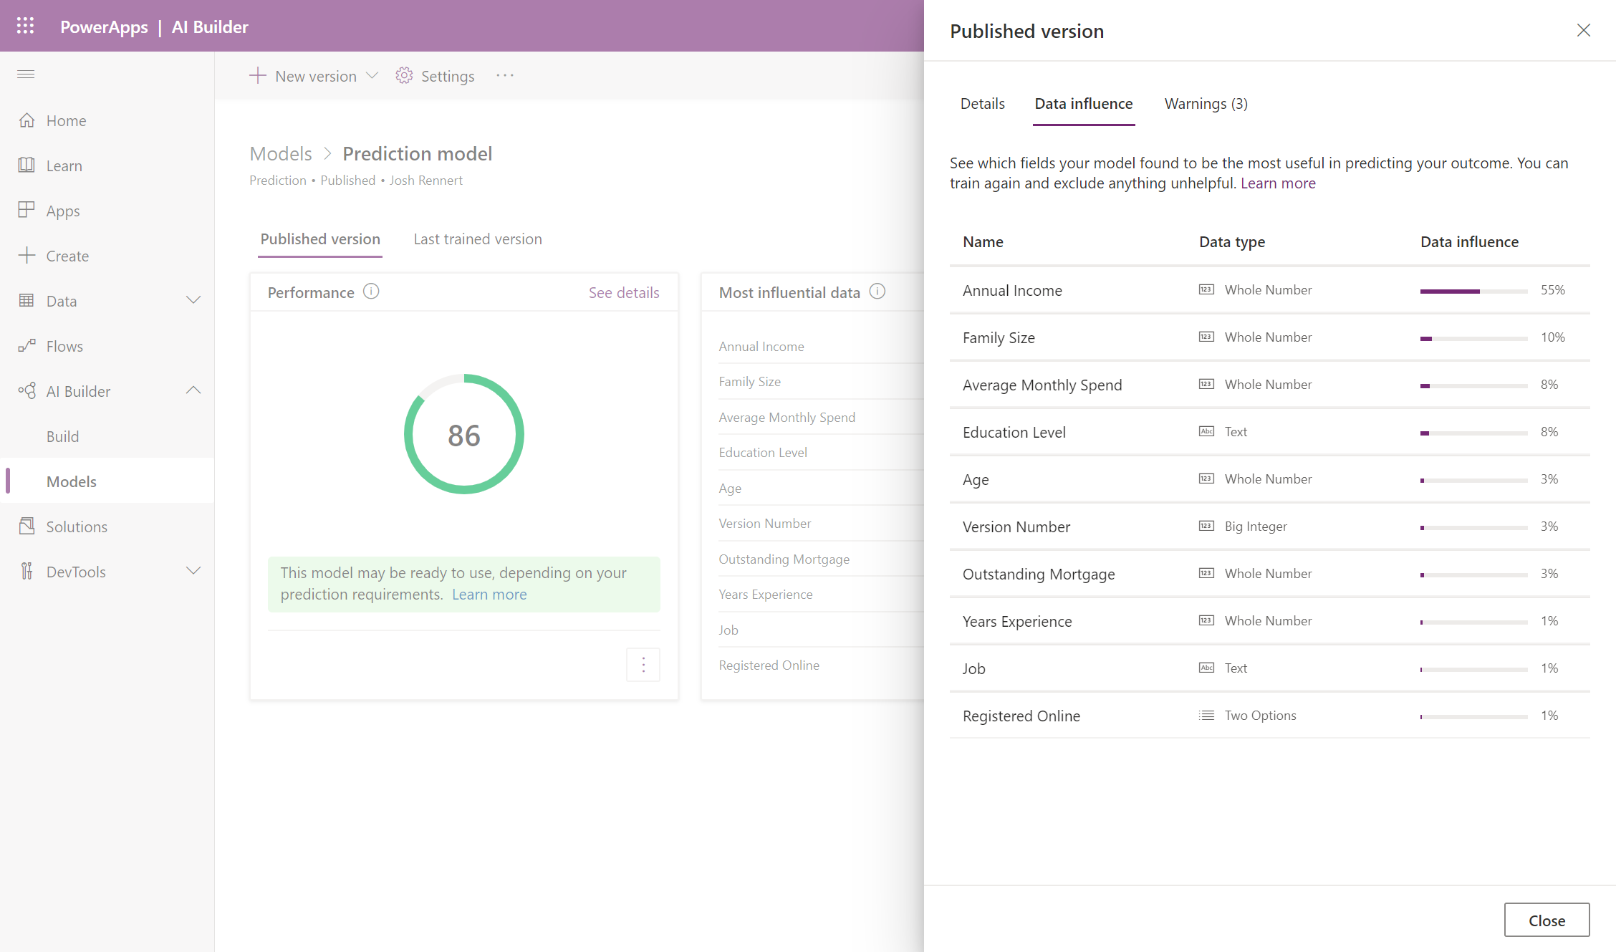
Custom models
Prediction Use your database and this AI model to determine the likelihood of specific business outcomes.
Form Processing ​(preview) Read, extract, and process data from scans, emails, PDFs, and images.​
Object Detection (preview)
Build an AI model that recognizes and counts visual objects.​
​​Text Classification ​(preview)
Build an application that reviews, tags, and classifies large volumes of text to track sentiment, improve customer experiences, and mine valuable insights.​

Slide 14
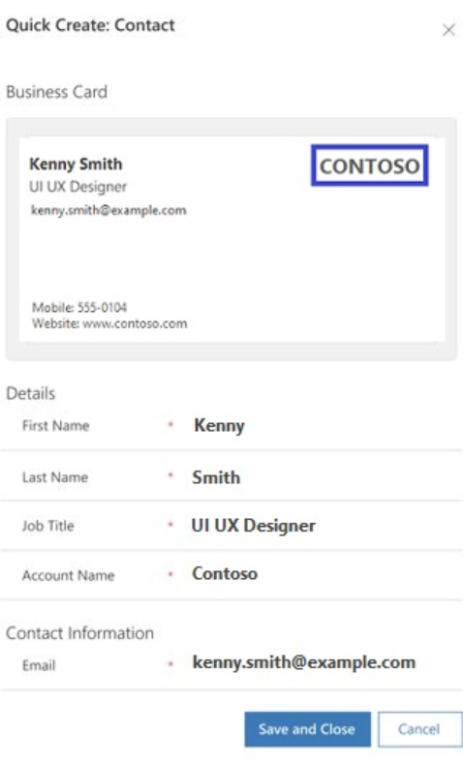
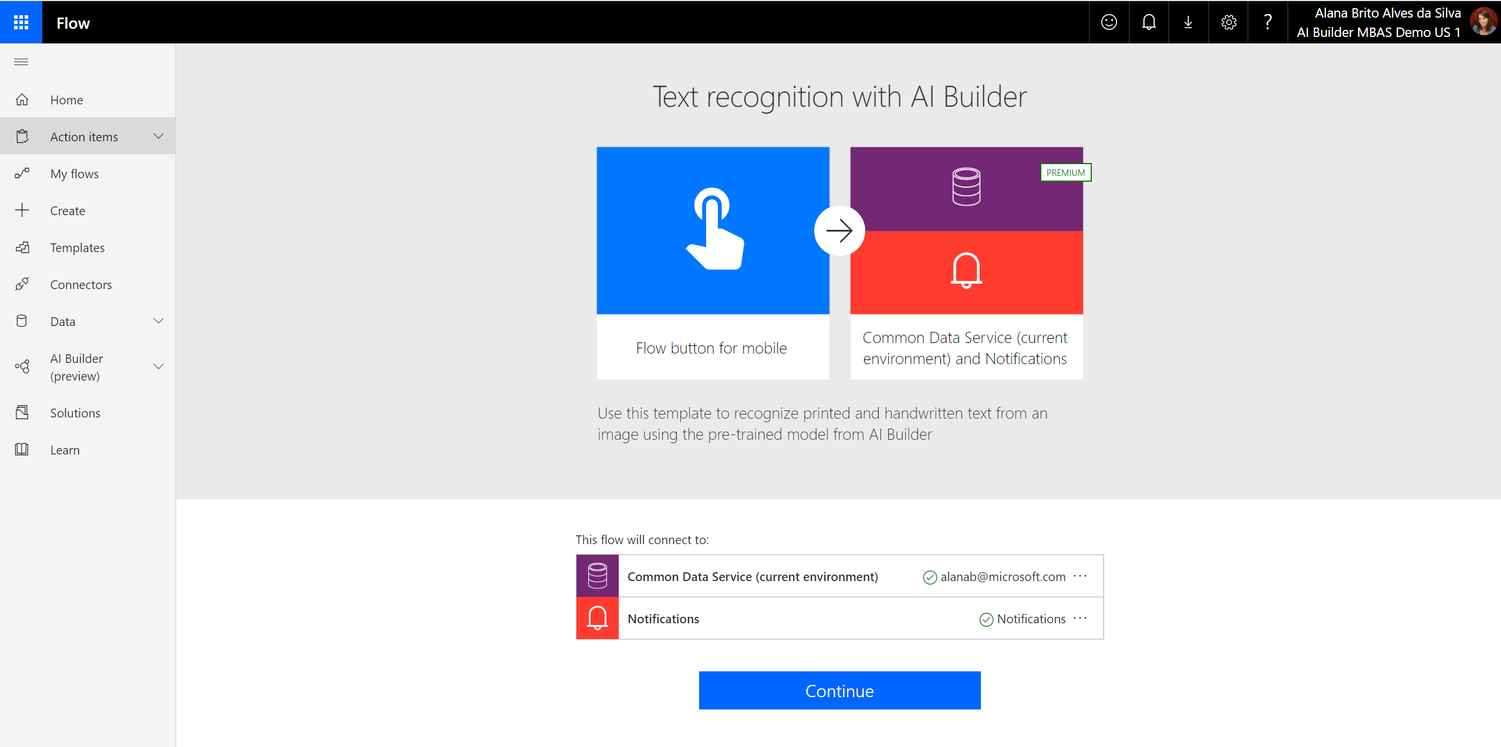
Prebuilt models
Business card reader​
Pull contact information from business cards, store this information in your database, and import it into your CRM system.​
Sentiment analysis (preview)
Detect positive, negative, neutral and mixed sentiment in social media, customer reviews or any text data you want to analyze.
Key phrase extraction (preview)
Extract the main points and key phrases in text documents.
Language detection (preview)
Use this model to identify the predominant language of a text document.
Text recognition (preview)
Extract embedded printed and handwritten text from documents and images into machine-readable character streams.

Slide 15
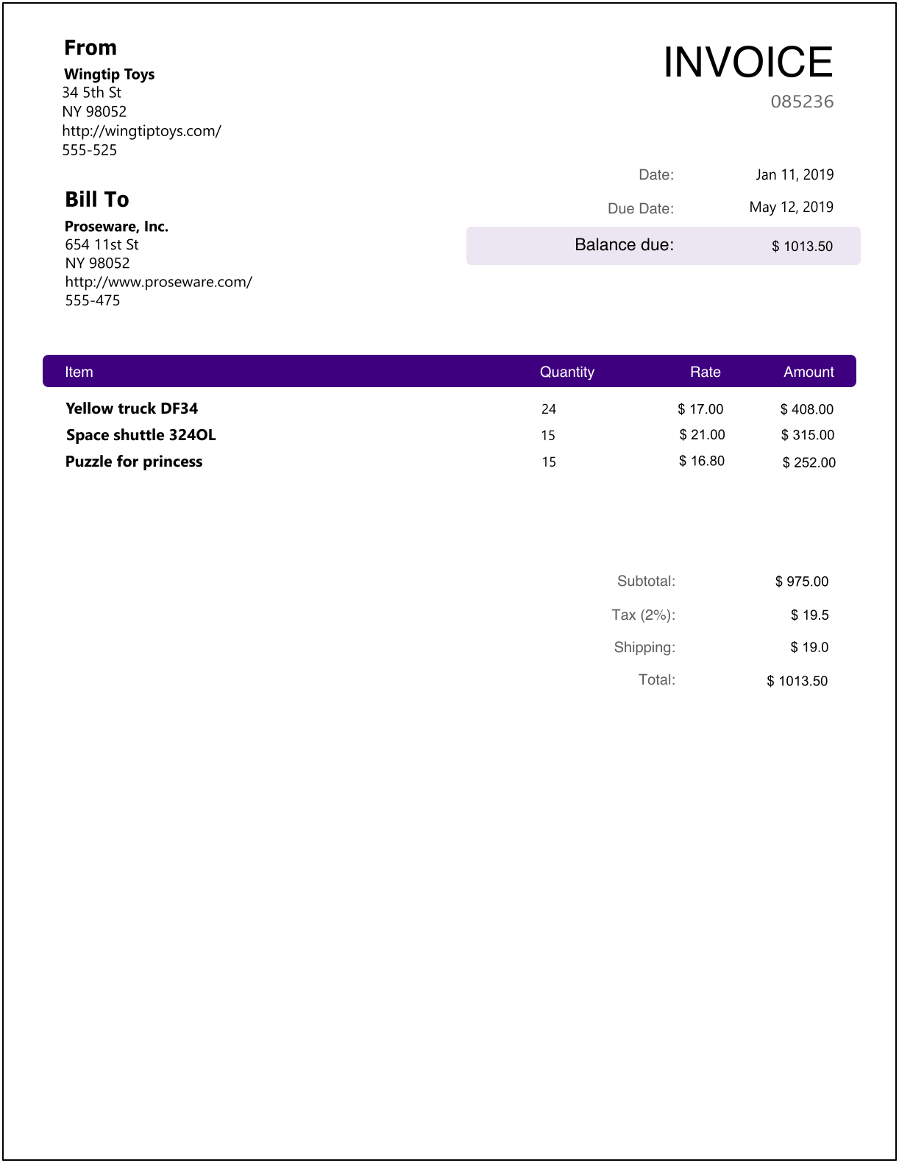
Demo - Form Processing Invoices
Minimum 5 documents to upload and analyze documents
Review documents and extracted data
Select your form fields
Train and validate your model

Slide 16
DEMO Form Processing (Invoices)

Slide 17
Try AI Builder today!
Try AI Builder now in Power Apps and Power Automate
https://aka.ms/PowerApps_AIBuilder
https://aka.ms/Flow_AIBuilder
https://docs.microsoft.com/en-us/ai-builder/learn-ai-builder
Check out the product overview video and release video
Read and share the blog by Charles Lamanna
and the AI Builder Ignite blog

Slide 18
AI Builder success rate
Forms Processing
Preview
GA: Q1 CY20
What we’ve heard
Lack of clarity on document and size limitations
Unsure why training failed and what to do next
Handwriting support
No ability to manually influence the model for fields that haven’t been automatically detected
Recent updates
Improved explanation of documents types and limits
Improved error management
Support for handwritten text
Q4 CY19
Q1 CY20
Ideas
Support for larger file sizes
Support for TIFF files
Manually tag fields not automatically detected
Combo box detection
Specialized model (e.g. invoices)
Multiple document types in one model

Slide 19
Any Questions?

Slide 20
Closing Notes & Goodies Distribution

